Slide 1
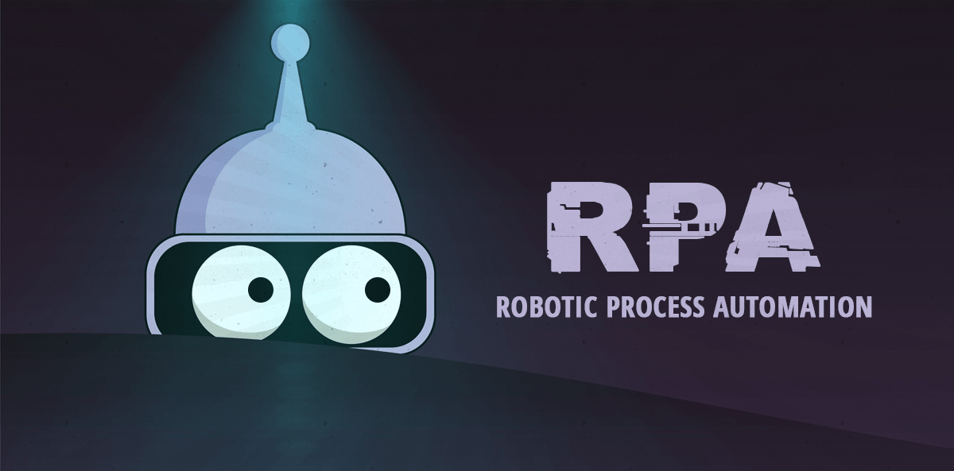

Slide 2
Robotic Process Automation -
Introduction
What is RPA?
Historic Evaluation
Why RPA?
Benefits of RPA
Myths about RPA

Slide 3
Robotic Process Automation -
Introduction
Lifecycle of RPA
RPA Implementation
Applications of RPA
Automation Architecture
RPA Tools
Why UiPath?

Slide 4
What is RPA
RPA Stand for Robotic Process Automation
Robotic : Machines which mimic human actions are called Robots.
Process : Sequence of steps which lead to a meaningful activity.
For example the process of making tea.
Automation : Any process which is done by a robot without human intervention.
To sum it up, mimicking human actions to perform a sequence of steps that lead to a meaningful activity, without any human intervention is known as Robotic Process Automation.
RPA allows task automation just like a human being was doing them across application and systems. It interacts with the existing IT architecture without any complex system integration requirement.
These software bots can interact with an in-house application, website, user portal, etc.
The main goal of Robotics process automation process to replace repetitive and boring clerical task performed by humans, with a virtual workforce.

Slide 5
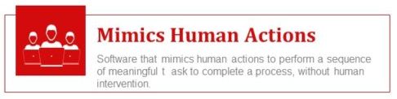

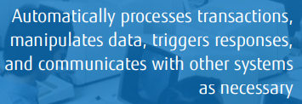
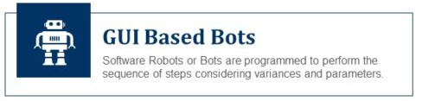
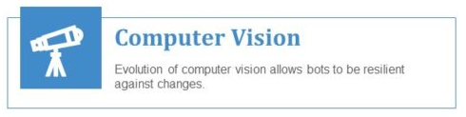

What is RPA

Slide 6
Historic Evaluation
following three key predecessors of RPA:
Screen Scraping Software
Business Process Automation
Artificial Intelligence
screen scraping solutions, available in 1990s were too brittle. They needed reprogramming with every tiny change in the UI because they relied on component identities in the UI modules.
By late 2000s, early 2010s, the screen scraping solutions relied more on image processing rather than hard coding component names.
Business process automation (BPA) solutions existed since 1990s
Finally, with the rise of Artificial Intelligence, companies became increasingly aware that machines could surpass humans in simple cognitive tasks like OCR or pattern recognition.
what makes RPA an impactful technology is, its ability to combine and refine certain aspects of each of these technologies

Slide 7
Why RPA?
Released Value: ​ RPA relieves humans of mundane tasks, allowing them to focus on more intellectually valuable activities that demand human creativity​​
​Reduced Error Rate: RPA reduce error rates which means less re-work and an enhanced reputation ​​
​​​Saves money: RPA is typically 30 - 65% cheaper than onshore workers and 10 – 30% of offshore​​
​Do more for less: RPA can process much greater volumes of work at much higher speed than a human​​
​​Fast: RPA can be implemented without any large scale systems integration, without disturbing existing systems and applications, so major productivity improvements can therefore be achieved quickly and cost effectively
​Auditable & Secure: Robots will only ever access what you tell them to; and will create a detailed audit trail of all activity

Slide 8
Benefits of RPA
ROI RPA offers a potential return of investment in the scale of 30% to 200% within the first 12 months.
Elimination of Human Error Robotic Process Automation, eliminated risk which resulted in greater accuracy.
Enhanced Customer Experience RPA can drive customer improvements. Through automation an organization can deliver quality services faster and decrease the chance of errors.
Greater Productivity When technology does the heavy lifting, as is the case with RPA, output can be significantly increased. Furthermore, knowledge workers will be freed up to apply their skills and experience to more important projects that drive innovation and growth.
Cost Savings By automating tasks, cost savings of nearly 30% can be achieved. Software robots also cost less than a full-time employee.

Slide 9
Myths about RPA
Robots will replace humans
in the workforce : What is actually happening is that robots are mostly
doing the work that humans hate.
Robots are 100% accurate : In a sense, the robots are really only as accurate as
how the robot developer programs them to be. This is because the RPA robots do not have any cognitive capabilities themselves.
A RPA developer doesn’t
require programming skills : Handling exceptions gracefully. Use of selectors
generating the scripts.
RPA is expensive: The annual cost of a robot is lower than the loaded wage of a FTE. One minute of work for a robot is roughly equivalent to fifteen minutes of work for a human employee.
Robots can automate
everything : Rule-based, High transaction volumes, Low exceptions, Stable and well-defined processes, Low system change, Structured data and readable electronic inputs

Slide 10
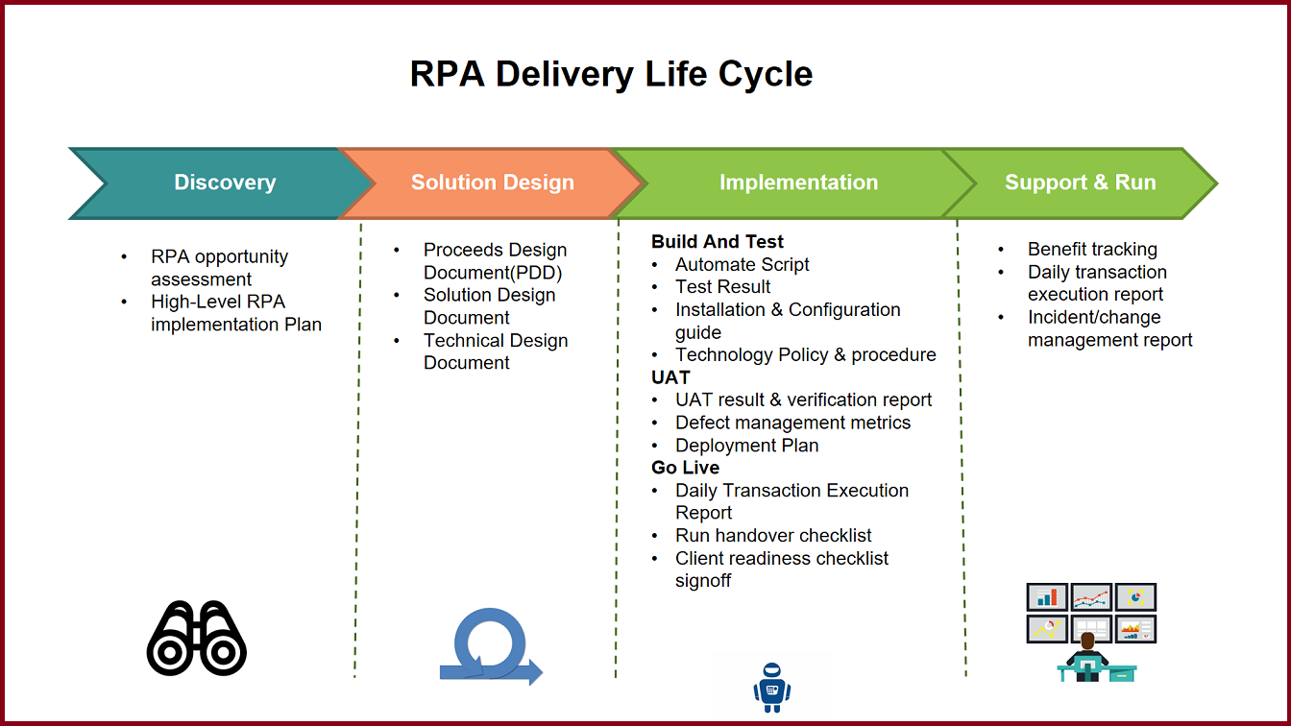
Lifecycle of RPA

Slide 11
RPA Implementation
For a successful RPA implementation −
Identify the automation opportunities.
Optimize the identified processes.
Build a business case for RPA journey.
Select the RPA vendor for implementation.
Start the bot development.
Expand RPA scope and continue building RPA bots.

Slide 12
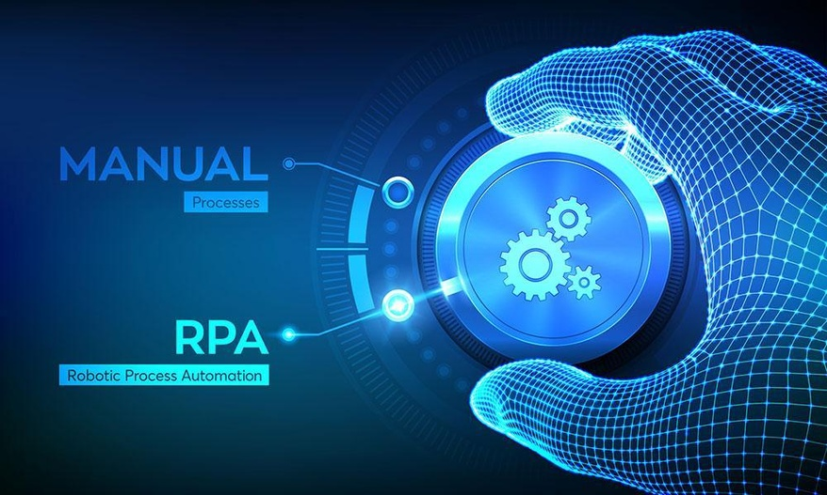
Process fit for RPA
The automation capabilities provided by RPA are ideal for tasks that are:
Repetitive
Rules-based
High volume
Do not require human judgement.
If a task checks every single one of these boxes, it’s probably a great fit for RPA.
A set of seven questions can help in process identification, if the answer to these questions is a YES:
1. Can the task be completed manually by a human sitting at a PC working with applications?
2. Does the business system lack an API or is the database behind the application inaccessible?
3. Does the core vendor charge extra for updating information in the business application?
4. Does a human worker perform the task more than once per week?
5. Does the task involve sensitive data?
6. Does the task need to be completed quickly with limited staffing resources?
7. Are there repetitive tasks that employees dislike?

Slide 13
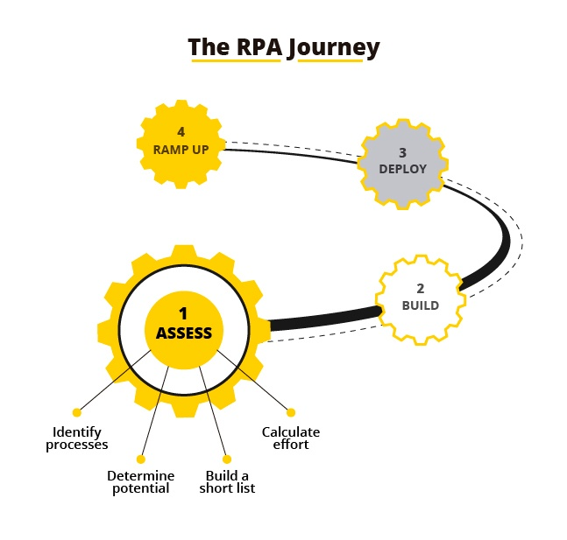
RPA Journey
Steps in a typical RPA journey
Identify the Automation Opportunities:
This should be first step of the RPA Journey,
Following area can help in identifying.
Automation opportunities.
Rule Driven Processes
Repetitive Processes
Data entry Processes
Volumes Driven Processes
Frequent human errors
Optimize the Identified Processes :
Optimize the ‘As Is’ process. Analyze the existing
process and identify the improvement areas.
Build Business Case for the RPA Journey

Slide 14
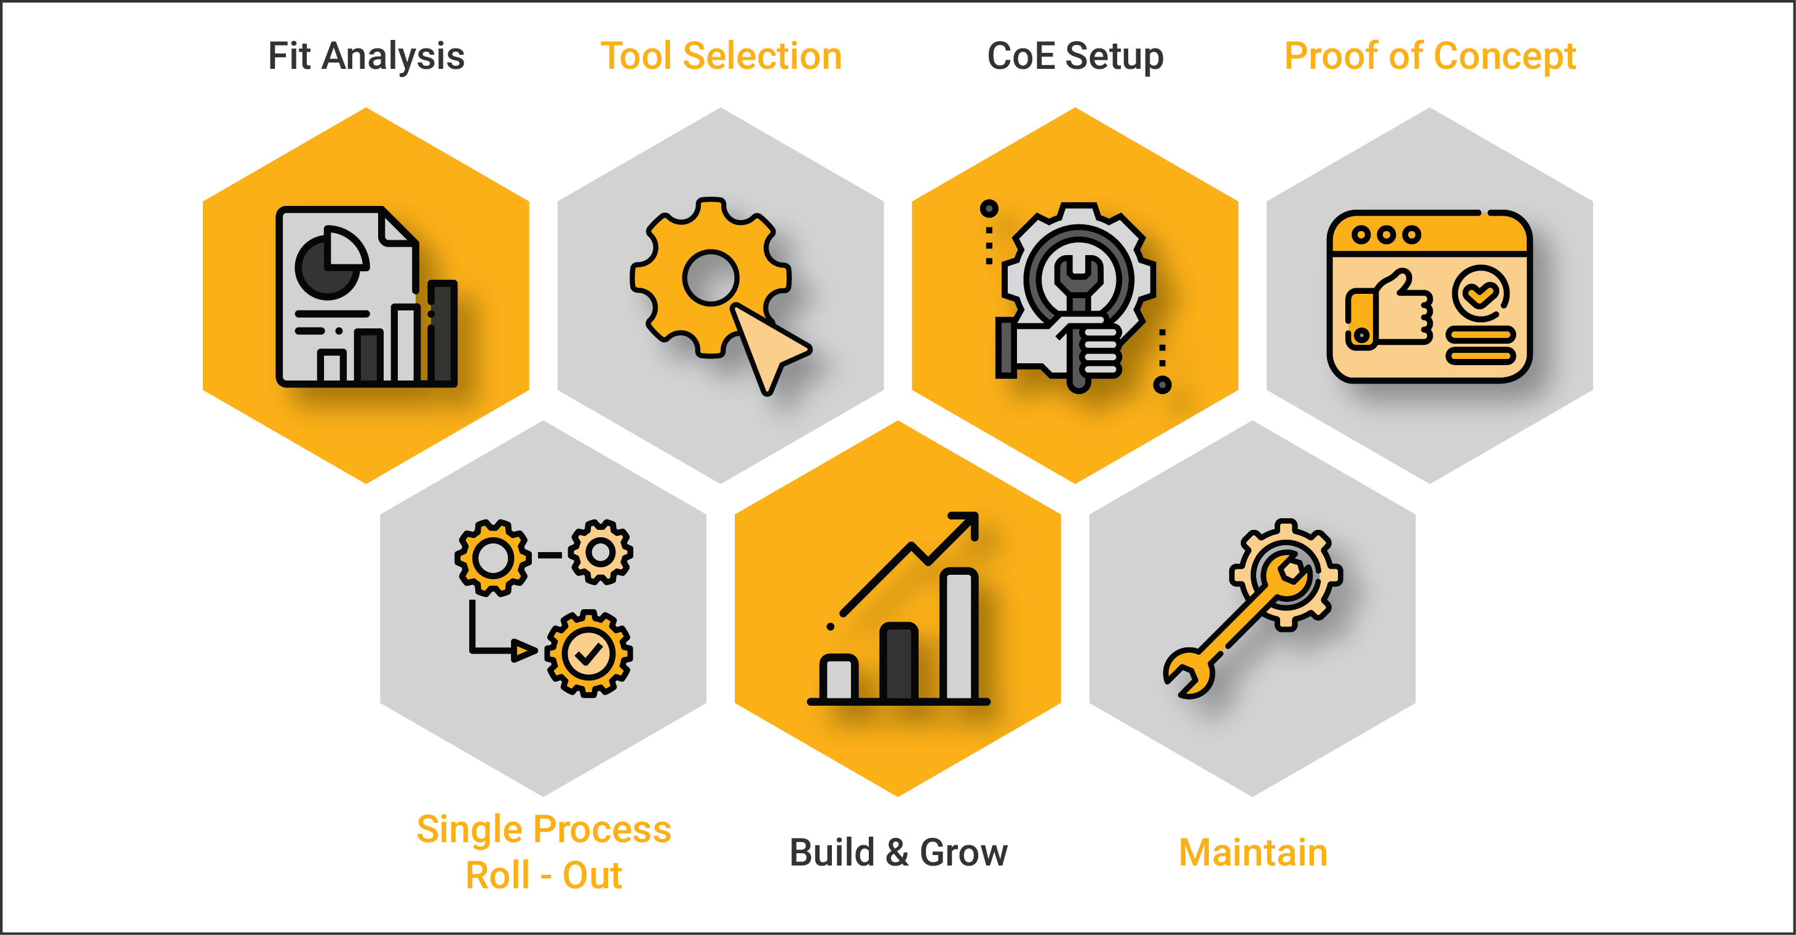
RPA Journey
RPA Vendor Selection :
Some of the factors to keep in mind while selecting RPA vendor:
Technology
Interface
Management
Security
Pricing
Pilot RPA Development :
Some of the factors need to be considered during the
pilot RPA development are:
How long should your pilot be?
Plan for the programming/development
Plan for the change management
Plan for the pilot launch
Plan for the risk management during the pilot stage.
Evaluate ‘What Went Well’ and ‘What Could Have Been Better”
Ramp up and Continue Building Expertise RPA bots

Slide 15
Applications of RPA
Industry | Usage
Healthcare | Patient registration Billing
HR | New employee joining formalities Payroll process Hiring shortlisted candidates
Insurance | Claims Processing & Clearance Premium Information
Manufacturing & Retail | Bills of material Calculation of Sales
Telecom | Service Order Management Quality Reporting

Slide 16
Applications of RPA
Industry | Usage
Travel & Logistic | Ticket booking Passenger Details Accounting
Banking and Financial Services | Cards activation Frauds claims Discovery
Government | Change of Address License Renewal
Infrastructure | Issues Processing Account setup and communication

Slide 17
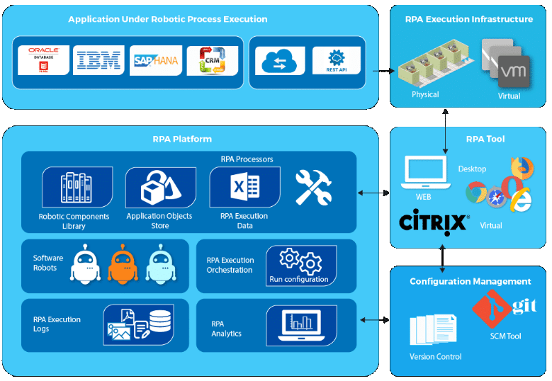
Automation Architecture

Slide 18
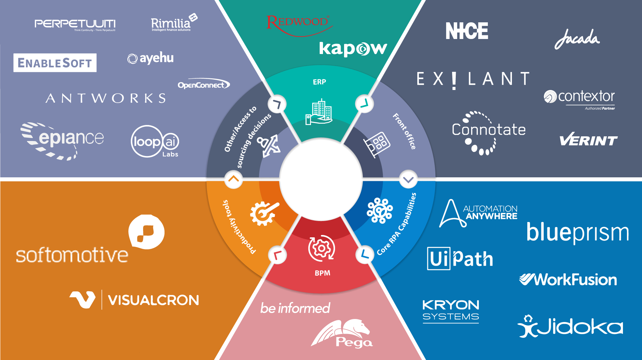
RPA Tools

Slide 19


Slide 20
Why UiPath?
Complete Solution
UiPath Studio (IDE for developers)
UiPath Orchestrator (centralized bot management, triggering, and logging)
Robots (service - attended or unattended)
Intuitive
Flowchart and/or sequence (nesting)
Drag & drop activities
Fast & easy to learn, which accelerates your process automation endeavor
Extensive Activity Library
Hundreds of pre-built, drag & drop actions (control-flow, web, desktop, API, DB, OCR)
Easy configuration
Faster automation changes
Secure
Credentials stored & encrypted remotely

Slide 21
Why UiPath?
Recording
Recorders for desktop apps, web apps, Citrix environment, and terminal emulators
Makes creating automation faster and more precise
Universal Search
Single search for all automation resources (libraries, activities, projects, and workflows)
Accelerates the automation development process
Extensible Via Code
Can design powerful & complex automations by incorporating custom VB.Net code
Customizations can be stored in the activity library and shared
Powerful Debugging
Intuitive & flexible
Step over, step into, slow step, highlights, etc.

Slide 22
Why UiPath?
Collaboration
Can store, protect, and share scripts in MS Team Foundation (TFS) and SVN
Promotes workflow re-use
Prevents loss
Facilitates parallel development and/or roll-backs
Third-Party Integration
Can plug in cognitive and OCR technologies from ABBYY, IBM Watson, Google, Microsoft text analysis at the API level
Server-Based Licensing
Centralized
Easy to manage

Slide 23
UiPath Installation
https://www.uipath.com/start-trial

